Slide 1
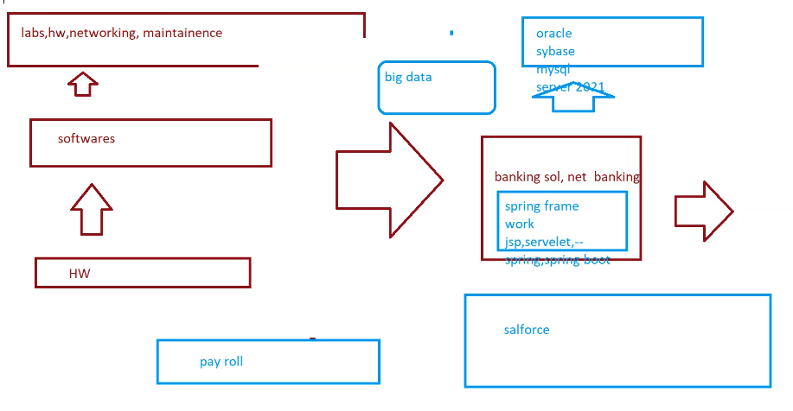

Slide 2
Structure data :
Semistructute data

Slide 3
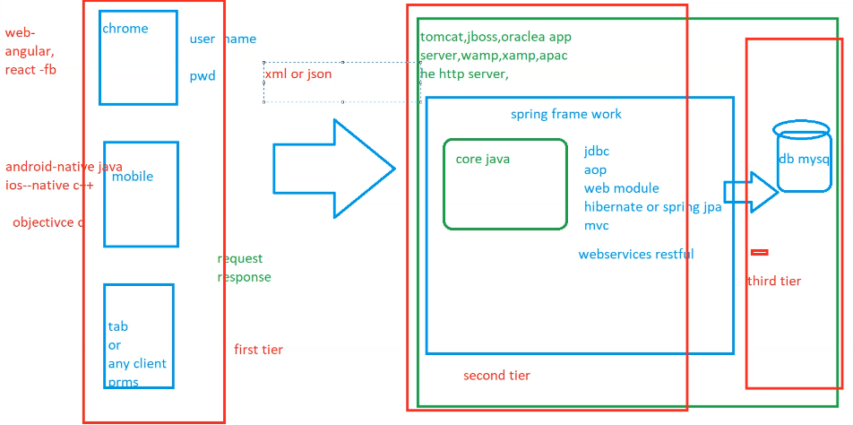

Slide 4
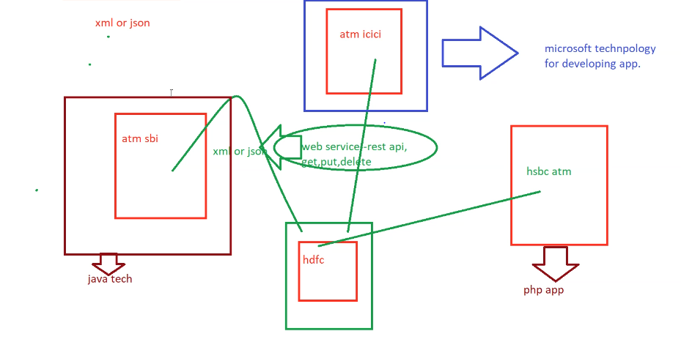

Slide 5
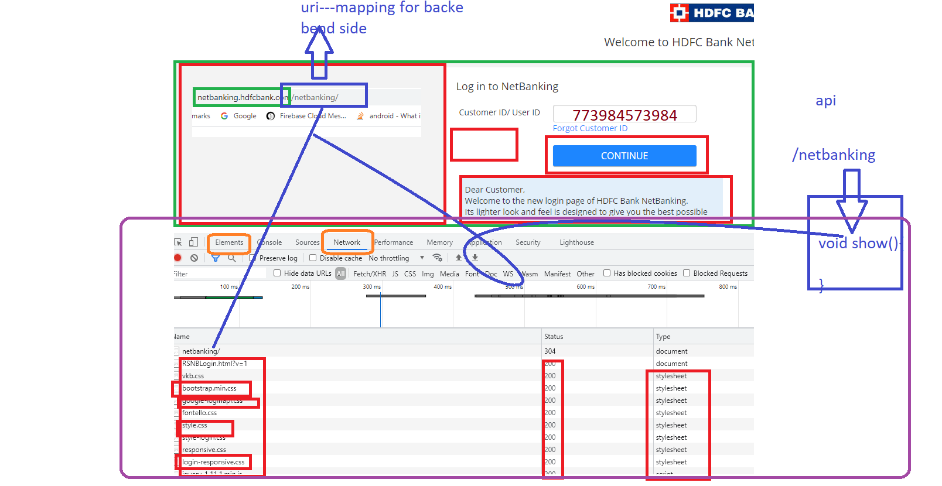

Slide 6
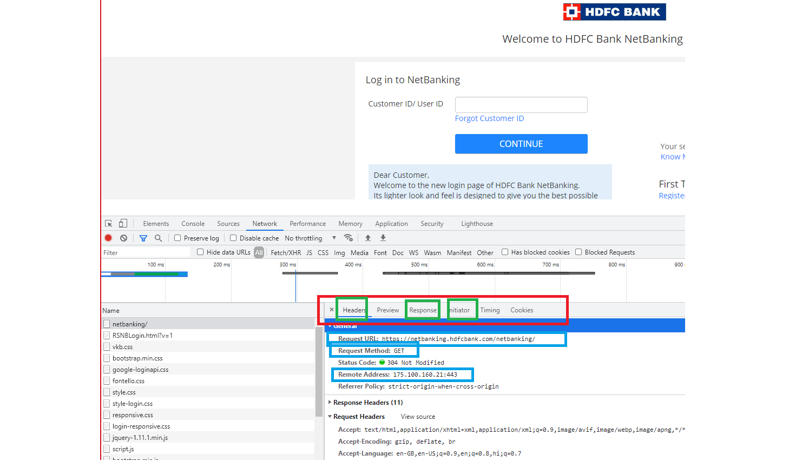

Slide 7
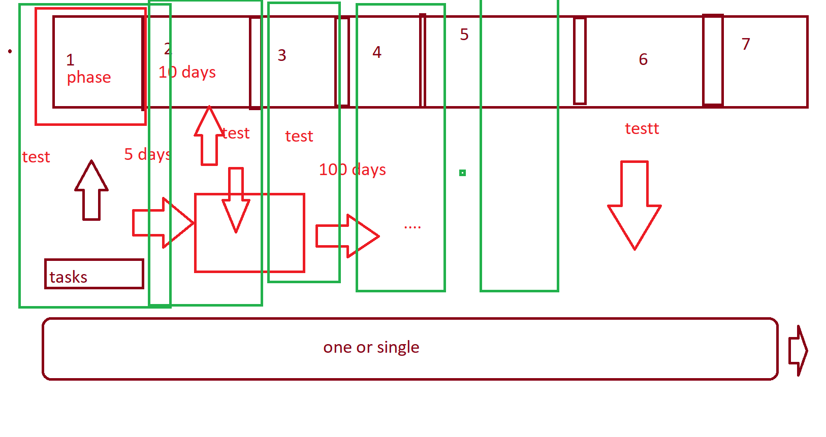

Slide 8
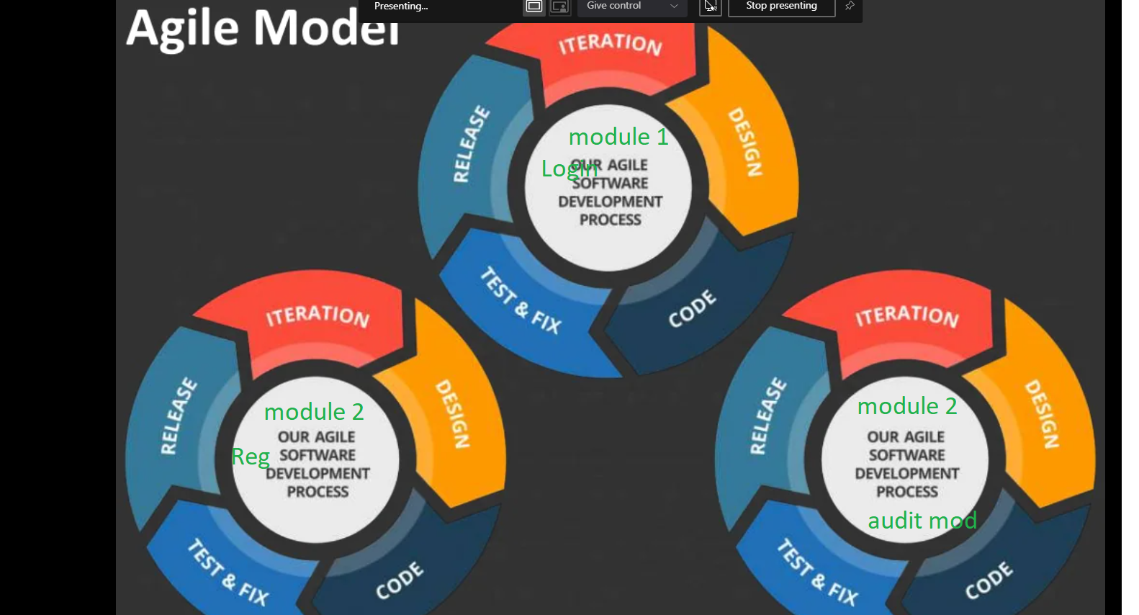

Slide 9
softwares assciates -0 to 2 years Software Engg -- +yeasers exp SR.Soft Engg + 3 years SCrum masters +10 years Business Analysts ,assc,BA,Sr BA+0 to 15 years UI Designers +5 years DAtabases designers +yes tech leads +9 years Ariechtect +15 years project managers->sr, pm,vip,sr vp,-director
--CFO,CTO,CEO

Slide 10
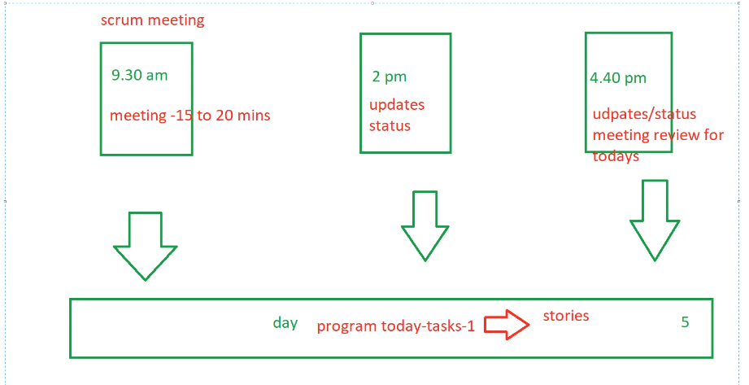

Slide 11
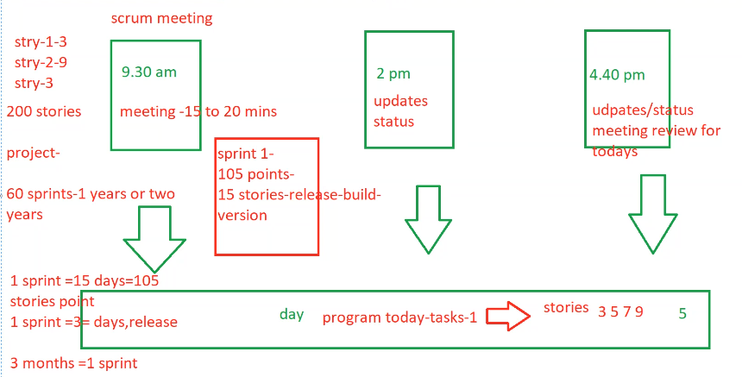

Slide 12
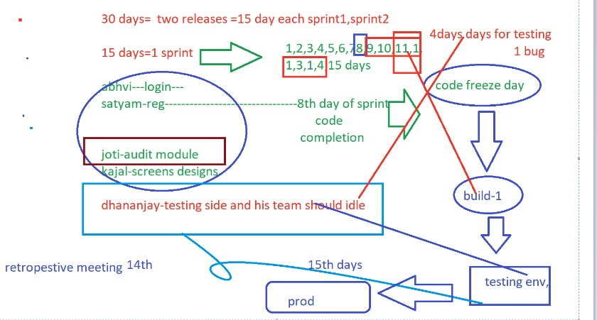

Slide 14
